Slide 1
Análise de Dados Diabetes
Lerina Mesquita Mastruian

Slide 2
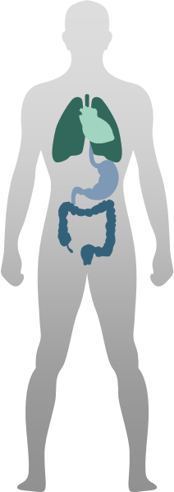
Conceitos
É uma doença causada pela produção insuficiente ou má absorção de insulina, hormônio que regula a glicose no sangue e garante energia para o organismo.
A insulina é um hormônio que tem a função de quebrar as moléculas de glicose (açúcar) transformando-a em energia para manutenção das células do nosso organismo.
O diabetes pode causar o aumento da glicemia e as altas taxas podem levar a complicações no coração, nas artérias, nos olhos, nos rins e nos nervos. Em casos mais graves, o diabetes pode levar à morte.
Fonte: https://www.gov.br/saude/pt-br/assuntos/saude-de-a-a-z/d/diabetes

Slide 3
Informações sobre Diabetes
Número de pessoas com diabetes mais que triplica em três décadas
As taxas crescentes de obesidade, má alimentação, falta de atividade física, entre outros fatores, contribuíram para mais que triplicar o número de adultos que vivem com diabetes nas Américas nos últimos 30 anos, de acordo com novo relatório da Organização Pan-Americana da Saúde (OPAS).
Aumento dos casos devido aumento dos fatores de risco
Dois terços dos adultos nas Américas estão com sobrepeso ou obesos, e apenas 60% fazem exercícios suficientes. O relatório também aponta para uma tendência alarmante entre os jovens da região: mais de 30% são considerados obesos ou com sobrepeso – quase o dobro da média global.
A diabetes é a sexta causa de mortalidade nas Américas
Foi responsável por mais de 284 mil mortes em 2019. Também é a segunda maior causa de incapacidade na região, precedida pela doença isquêmica do coração. A diabetes é a principal causa de cegueira em pessoas de 40 a 74 anos, amputações de membros inferiores e doença renal crônica. Além disso, triplica o risco de morte por doença cardiovascular, doença renal ou câncer.
Fonte: https://www.paho.org/pt/noticias/11-11-2022-numero-pessoas-com-diabetes-nas-americas-mais-do-que-triplica-em-tres-decadas

Slide 4
Premissas da análise
Dataset
Diabetes prediction dataset | Kaggle
Possui 1000 linhas e 9 colunas
Não foi realizada a exclusão de linhas
Dados
Dados disponíveis: Idade, Gênero, Índice de Massa Corpórea (IMC), Hipertensão, Doenças do coração, Histórico de Tabagismo , Hemoglobina Glicada e Nível de Açúcar no sangue.
Dados Duplicados
Encontramos no conjunto a quantidade de 3854 dados duplicados, mas como não temos dados de ID neste dataset, preferimos não excluir, pois poderiam ser dados diferentes
Jupiter
Jupiter is a gas giant and the biggest planet in the Solar System

Slide 6
Distribuição de Gênero
58%
41%
47%
52%
Mars
Saturn
Mars
Saturn
Despite being red, Mars is actually a cold place full of iron oxide dust
Saturn have rings and is composed mostly of hydrogen and helium

Slide 7
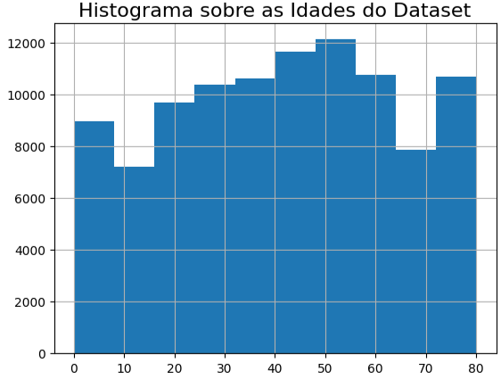
Histograma
Jupiter
A faixa de idade predominante no conjunto de dados está entre 20 e 60 anos

Slide 8
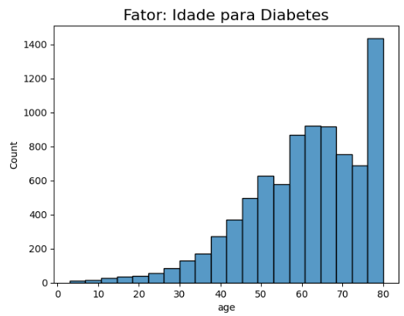
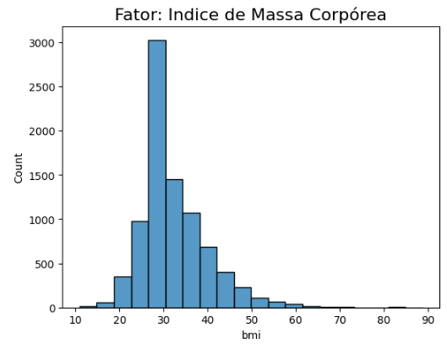
Fator : Diabéticos

Slide 9
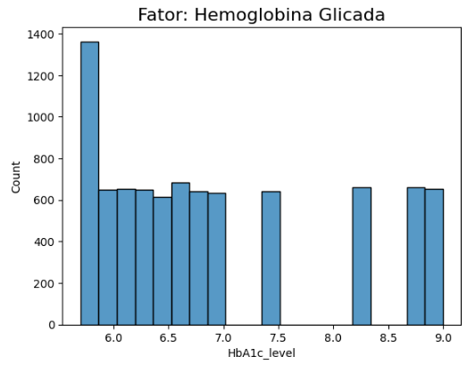
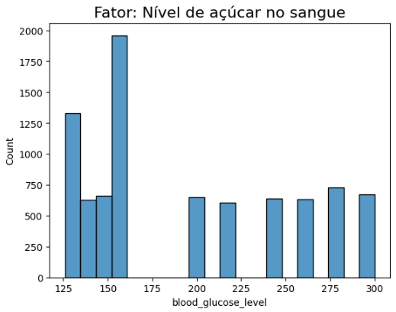
Fator : Diabéticos

Slide 10
Colocando o parâmetro de 200 onde o indivíduo já seria classificado como diabético:
**Idade**: Podemos comentar que nesses indíviduos a diabete começa aos 40 anos, onde começamos a ter outros patamares de valores de 800 a 1400 no grupo de idade entre 55 a 80 anos.
**Índice de massa corpórea**: Os indivíduos desse grupo na sua maioria estão com IMC variando entre 25 - 40, já indicando que os mesmos estão na faixa de sobrepeso e obesidade grau I e II
**Hemoglobina Glicada**: A maior quantidade de indivíduos está nas faixas de 5,5 a 7,0
**Nível de acúçar no sangue**: Os indivíduos desse grupo na sua maioria estão com fator de acúçar no sangue variando entre 125 e 160

Slide 11
Gradient Medical Infographics
MERCURY
Planet Mercury is also the smallest planet of all of them in the Solar System
MARS
Despite being red, planet Mars is actually a very cold place full of iron oxide dust
NEPTUNE
Neptune is the eighth planet and farthest-known one from the Sun of all of them

Slide 12
Gradient Medical Infographics
40%
30%
20%
Mercury
Mars
Saturn
Mercury is the smallest planet in the Solar System and the closest to the Sun
Despite being red, Mars is actually a cold place full of iron oxide dust
Saturn have rings and is composed mostly of hydrogen and helium

Slide 13
Gradient Medical Infographics
Venus
Venus has a beautiful name and is the second one from the Sun
Mercury
Mercury is the closest planet to the Sun and the smallest one
Mars
Despite being red, Mars is a cold place full of iron oxide dust
Jupiter
Jupiter is a gas giant and the biggest planet in the Solar System

Slide 14
Gradient Medical Infographics
Venus
Venus has a beautiful name and is the second planet
Mercury
39 Weeks
Mercury is the closest planet to the Sun and the smallest one
28 Weeks
Mars
Mars is actually a cold place full of iron oxide dust
20 Weeks
8 Weeks
Jupiter
Jupiter is a gas giant and the biggest one of all of them

Slide 15
Gradient Medical Infographics
36.2 º
37.5 º
Mercury
Mars
Mercury is the smallest planet in the Solar System and the closest to the Sun
Despite being red, Mars is actually a cold place full of iron oxide dust

Slide 16
Gradient Medical Infographics
80%
40%
20%
10%
Phase 4
Phase 3
Phase 2
Phase 1
Mercury is the closest planet to the Sun
Planet Venus has also a beautiful name
Despite being red, Mars is a cold place
Jupiter is a gas giant and the biggest planet

Slide 17
Gradient Medical Infographics
Phase 02
Phase 04
Planet Venus has also a beautiful name
Jupiter is a gas giant and the biggest planet
02
04
01
03
Phase 01
Phase 03
Mercury is the closest planet to the Sun
Despite being red, Mars is a cold place

Slide 18
Gradient Medical Infographics
80%
MERCURY
NEPTUNE
Mercury is the smallest planet in the Solar System and the closest to the Sun
Neptune is the eighth planet and farthest-known planet from the Sun
60%
40%
MARS
20%
JUPITER
Despite being red, Mars is actually a cold place full of iron oxide dust
Planet Jupiter is a gas giant and the biggest planet in the Solar System

Slide 19
Gradient Medical Infographics
Venus
Venus is the second planet from the Sun and has a beautiful name
Mercury
Mercury is the closest planet to the Sun and the smallest one
Mars
Despite being red, Mars is actually a cold place full of iron oxide dust

Slide 20
Gradient Medical Infographics
Mercury
Mars
Mercury is the smallest planet in the Solar System and the closest to the Sun
Despite being red, Mars is actually a very cold place full of iron oxide dust

Slide 21
Gradient Medical Infographics
Mercury
Mars
Saturn
Mercury is the smallest planet in the Solar System and the closest to the Sun
Despite being red, Mars is actually a cold place full of iron oxide dust
Saturn have rings and is composed mostly of hydrogen and helium

Slide 22
Gradient Medical Infographics
MERCURY
NEPTUNE
Mercury is the smallest planet in the Solar System and the closest to the Sun
Neptune is the eighth planet and farthest-known planet from the Sun
MARS
JUPITER
Despite being red, Mars is actually a cold place full of iron oxide dust
Planet Jupiter is a gas giant and the biggest planet in the Solar System

Slide 23
Gradient Medical Infographics
Phase 01
Phase 02
Phase 03
Phase 04
Mercury is the closest planet to the Sun
Planet Venus has also a beautiful name
Despite being red, Mars is a cold place
Jupiter is a gas giant and the biggest planet

Slide 24
Gradient Medical Infographics
Mercury is the closest one and the smallest one also
Neptune is the eighth and the farthest-known planet
Mars despite being red and is a very cold place
Saturn is composed mostly of hydrogen and helium
Jupiter is the biggest one in the Solar System
Planet Earth is the only planet with life in the Solar System
Private Health Insurance
Public Health Insurance

Slide 25
Gradient Medical Infographics
Mars
Mars is now a cold place full of iron oxide dust
Jupiter
Venus
Jupiter is a gas giant and the biggest planet
Venus is the second one and has a beautiful name
Mercury
Mercury is the closest planet to the Sun

Slide 26
Gradient Medical Infographics
MERCURY
NEPTUNE
Mercury is the smallest planet in the Solar System and the closest to the Sun
Neptune is the eighth planet and farthest-known planet from the Sun
MARS
JUPITER
Despite being red, Mars is actually a cold place full of iron oxide dust
Planet Jupiter is a gas giant and the biggest planet in the Solar System

Slide 27
Gradient Medical Infographics
25%
Mercury
Mars
75%
Mercury is the smallest planet in the Solar System and the closest to the Sun
Despite being red, Mars is actually a very cold place full of iron oxide dust

Slide 28
Gradient Medical Infographics
Mercury
Jupiter
Mercury is the closest planet to the Sun and the smallest one
It’s a gas giant and the biggest planet in the Solar System
Mars
Venus
Mars is a cold place and it’s full of iron oxide dust
Venus is the second planet from the Sun and it’s terribly hot

Slide 29
Gradient Medical Infographics
Pros
VS
Cons
Jupiter
Jupiter
It’s a gas giant and the biggest planet
It’s a gas giant and the biggest planet
Venus
Venus
Venus is the second planet from the Sun
Venus is the second planet from the Sun
Saturn
Saturn
Saturn is the ringed one. It’s a gas giant
Saturn is the ringed one. It’s a gas giant

Slide 30
Gradient Medical Infographics
Mercury
Neptune
Mercury is the smallest planet of all of them
Neptune is the eighth and farthest-known planet
Mars
Jupiter
Despite being red, Mars is actually a cold place
Planet Jupiter is a gas giant and the biggest one
Saturn
Venus
Saturn is composed mostly of hydrogen and helium
Venus is the second planet from the Sun

Slide 31
Gradient Medical Infographics
40%
20%
Mercury
Jupiter
Mercury is the closest planet to the Sun and the smallest one
It’s a gas giant and the biggest planet in the Solar System
30%
10%
Mars
Venus
Mars is a cold place and it’s full of iron oxide dust
Venus is the second planet from the Sun and it’s terribly hot

Slide 32
Gradient Medical Infographics
MERCURY
NEPTUNE
Mercury is the smallest planet of all of them
Neptune is the eighth and farthest-known planet
MARS
JUPITER
Despite being red, Mars is actually a cold place
Planet Jupiter is a gas giant and the biggest one
SATURN
VENUS
Saturn is composed mostly of hydrogen and helium
Venus is the second planet from the Sun
EARTH
SUN
Planet Earth is the only planet with life
The Sun is the star at the center of the Solar System

Slide 33
Gradient Medical Infographics
MERCURY
NEPTUNE
Mercury is the smallest planet in the Solar System and the closest to the Sun
Neptune is the eighth planet and farthest-known planet from the Sun
MARS
JUPITER
Despite being red, Mars is actually a cold place full of iron oxide dust
Planet Jupiter is a gas giant and the biggest planet in the Solar System

Slide 34
Gradient Medical Infographics
Despite being red, planet Mars is actually a very cold place
It is the ringed planet. It is composed of hydrogen and helium
Jupiter is a gas giant and the biggest object in the Solar System
Mercury is the closest planet to the Sun and the smallest one
Mars
Saturn
Jupiter
Mercury

Slide 35
Gradient Medical Infographics
01
Planet Jupiter is a gas giant and the biggest planet of all of them in the Solar System
02
Saturn is the ringed planet and also It is composed mostly of hydrogen and helium
03
Despite being red, planet Mars is actually a very cold place full of iron oxide dust
04
Mercury is the closest planet to the Sun and also is the smallest one in the Solar System

Slide 36
Gradient Medical Infographics
Mercury
Mercury is the closest planet to the Sun and the smallest one in the Solar System
Jupiter
Jupiter It’s a gas giant and the biggest planet of all of them in the Solar System

Slide 37
Gradient Medical Infographics
Mercury
Saturn
Mercury is the closest planet to the Sun and the smallest one
It is the ringed planet. It is composed of hydrogen and helium
Jupiter
Mars
Jupiter is a gas giant and the biggest object in the Solar System
Despite being red, planet Mars is a very cold place

Slide 38
Gradient Medical Infographics
Mercury
Saturn
Mercury is the closest planet to the Sun and the smallest one
It is the ringed planet. It is composed of hydrogen and helium
Mars
Jupiter
Despite being red, planet Mars is actually a very cold place
Jupiter is a gas giant and the biggest object in the Solar System

Slide 39
Instructions for use (free users)
In order to use this template, you must credit Slidesgo by keeping the Thanks slide.
You are allowed to:
Modify this template.
Use it for both personal and commercial purposes.
You are not allowed to:
Sublicense, sell or rent any of Slidesgo Content (or a modified version of Slidesgo Content).
Distribute this Slidesgo Template (or a modified version of this Slidesgo Template) or include it in a database or in any other product or service that offers downloadable images, icons or presentations that may be subject to distribution or resale.
Use any of the elements that are part of this Slidesgo Template in an isolated and separated way from this Template.
Delete the “Thanks” or “Credits” slide.
Register any of the elements that are part of this template as a trademark or logo, or register it as a work in an intellectual property registry or similar.
For more information about editing slides, please read our FAQs or visit Slidesgo School:
https://slidesgo.com/faqs and https://slidesgo.com/slidesgo-school

Slide 40
Instructions for use (premium users)
In order to use this template, you must be a Premium user on Slidesgo.
You are allowed to:
Modify this template.
Use it for both personal and commercial purposes.
Hide or delete the “Thanks” slide and the mention to Slidesgo in the credits.
Share this template in an editable format with people who are not part of your team.
You are not allowed to:
Sublicense, sell or rent this Slidesgo Template (or a modified version of this Slidesgo Template).
Distribute this Slidesgo Template (or a modified version of this Slidesgo Template) or include it in a database or in any other product or service that offers downloadable images, icons or presentations that may be subject to distribution or resale.
Use any of the elements that are part of this Slidesgo Template in an isolated and separated way from this Template.
Register any of the elements that are part of this template as a trademark or logo, or register it as a work in an intellectual property registry or similar.
For more information about editing slides, please read our FAQs or visit Slidesgo School:
https://slidesgo.com/faqs and https://slidesgo.com/slidesgo-school

Slide 41
Infographics
You can add and edit some infographics to your presentation to present your data in a visual way.
Choose your favourite infographic and insert it in your presentation using Ctrl C + Ctrl V or Cmd C + Cmd V in Mac.
Select one of the parts and ungroup it by right-clicking and choosing “Ungroup”.
Change the color by clicking on the paint bucket.
Then resize the element by clicking and dragging one of the square-shaped points of its bounding box (the cursor should look like a double-headed arrow). Remember to hold Shift while dragging to keep the proportions.
Group the elements again by selecting them, right-clicking and choosing “Group”.
Repeat the steps above with the other parts and when you’re done editing, copy the end result and paste it into your presentation.
Remember to choose the “Keep source formatting” option so that it keeps the design. For more info, please visit Slidesgo School.

